Slide 1
LinkedIn

Slide 2
LinkedIn
One of the most important social media platforms for job searching and networking.
It is imperative to have one as you job search!

Slide 3
What is LinkedIn?
LinkedIn is a business-oriented social networking service.
Most of the site's revenue comes from selling access to information about its users to recruiters and sales professionals

Slide 4
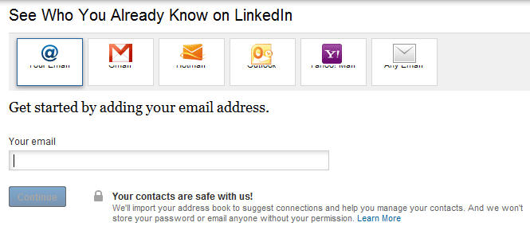
LinkedIn Connections
You can use your email contacts to get connections!

Slide 5
LinkedIn
Go to www.linkedin.com and create a profile!
Explore the website a bit and complete this lecture!

Slide 6
LinkedIn Recommendations
Start off by asking people you have worked under or with to give you recommendations.
Thank them and if possible return the favor by recommending them back.
You can also ask professors and teachers to leave recommendations for your education.
Again, only ask people you personally know!

Slide 7
LinkedIn Skill Endorsements
Having scores might give your profile an edge.
Recruiters sometimes keep an eye out for these.
They’re actual usefulness is debatable, different people vary their perception of the seriousness of an endorsement.

Slide 8
LinkedIn Following
You can follow people on LinkedIn
If you produce content (blog posts, articles, new code, etc…) you can post it on Linkedin to your followers!
They will see it in their feed and get notified.
You can also add a “follow me” button to your personal website!

Slide 9
LinkedIn as a Job Search Tool
LinkedIn has its own job hunting platoform!
Check it out at www.linkedin.com/jobs

Slide 10
LinkedIn Premium
LinkedIn Premium allows you to InMail people (such as recruiters).
Allows you to connect with and contact recruiters directly.
Gives you improved information in LinkedIn’s Job Search tools.
One month free trial.

Slide 11
Discussion Etiquette
Please be polite and thoughtful when posting your LinkedIn Profile to the discussion boards.
Feel free to post if you genuinely need help, and try to give honest feedback to others.
However don’t just spam the boards with your profile!

Slide 12
LinkedIn Homework
Create a LinkedIn Profile
Update your picture
Complete your profile information
Get 10 connections
Get a connection to a recruiter

